Slide 1
Procedures, Functions, Triggers

Slide 2
Procedures

Slide 3
PL/SQL Blocks and Procedures
Up to now we have coded in PL/SQL using an anonymous block ( DECLARE..BEGIN…END)
These blocks are compiled each time they are issued.
They are not stored in the database.
They cannot be called directly from another PL/SQL block.
Procedures and Functions are named blocks of PL/SQL code.
Notes:
Procedures and Functions can be stored in the database and run when needed.

Slide 4
Procedures
They behave very much like procedures in any other 3GL Language.
Procedures and Functions collectively are known as sub-programs.
Basic Syntax:
CREATE[OR REPLACE] PROCEDURE procedure_name
[(argument[{IN|OUT|IN OUT}] type, ….
[(argument[{IN|OUT|IN OUT}] type)] {IS| AS}
procedure_body
Notes:
procedure_name – is the name of the procedure to be created
Argument – is the name of the procedure parameter (if any)
Type – is the type of the parameter if any.
Procedure body is PL/SQL block that make up the code of the procedure

Slide 5
Parts of a PL/SQL Subprogram
Declarative Part
It is an optional part. However, the declarative part for a subprogram does not start with the DECLARE keyword. It contains declarations of types, cursors, constants, variables, exceptions, and nested subprograms. These items are local to the subprogram and cease to exist when the subprogram completes execution.
Executable Part
This is a mandatory part and contains statements that perform the designated action.
Exception-handling This is again an optional part. It contains the code that handles run-time errors.

Slide 6
Procedures
In order to change the code of a procedure the existing procedure must be dropped first.
Structure of a procedure creation statement looks like this:
CREATE OR REPLACE PROCEDURE procedure_name(parameter_list) AS
/*Declarative section here*/
BEGIN
/*Executable section here*/
EXCEPTION
/* Exception handling section here*/
END[procedure_name]
Notes:
NOTE: When a procedure is being created changes are being made regularly. To faciliate a large number of changes to the procedure you can use the OR REPLACE keywords. When using this, if the procedure exists it is dropped first, without a warning message (DROP PROCEUDRE can be used to drop a procedure) If the procedure does not already exist it will create it.
After the End statement the procedure name can be included altough it is option.

Slide 7
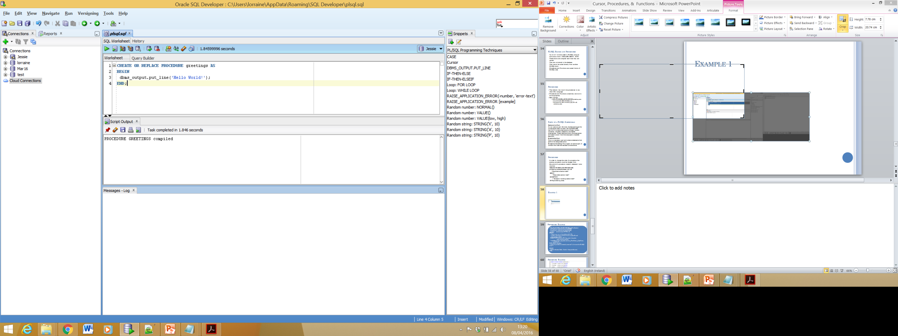
Example 1: Hello World
Result when executed

Slide 8
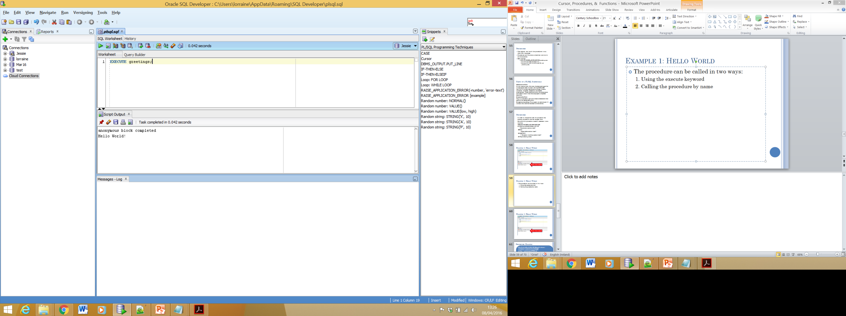
Example 1: Hello World
The procedure can be called in two ways:
1. Using the execute keyword
2. Calling the procedure by name
Execute Keyword:

Slide 9
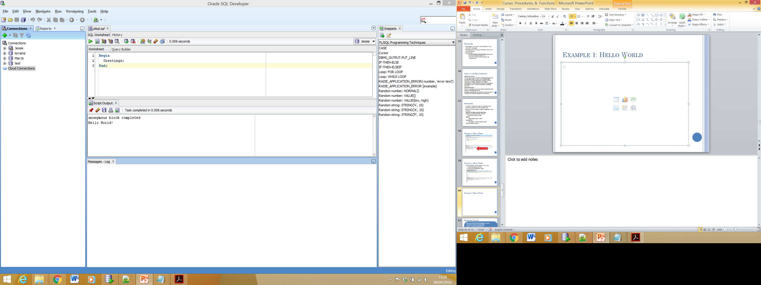
Example 1: Hello World
2. Calling the procedure by name,
procedure may be called from another PL/SQL block

Slide 10
Example 2
CREATE OR REPLACE PROCEDURE AddNewStudent (
p_FirstName students.first_name%TYPE,
p_LastName students.last_name%TYPE,
p_Major students.major%TYPE) AS
BEGIN
-- Insert a new row in the students table. Use
-- student_sequence to generate the new student ID, and
-- 0 for current_credits.
INSERT INTO students (ID, first_name, last_name,
major, current_credits)
VALUES (student_sequence.nextval, p_FirstName, p_LastName,
p_Major, 0);
END AddNewStudent;
/*Once this procedure is created, we can call it from another PL/SQL block*/

Slide 11
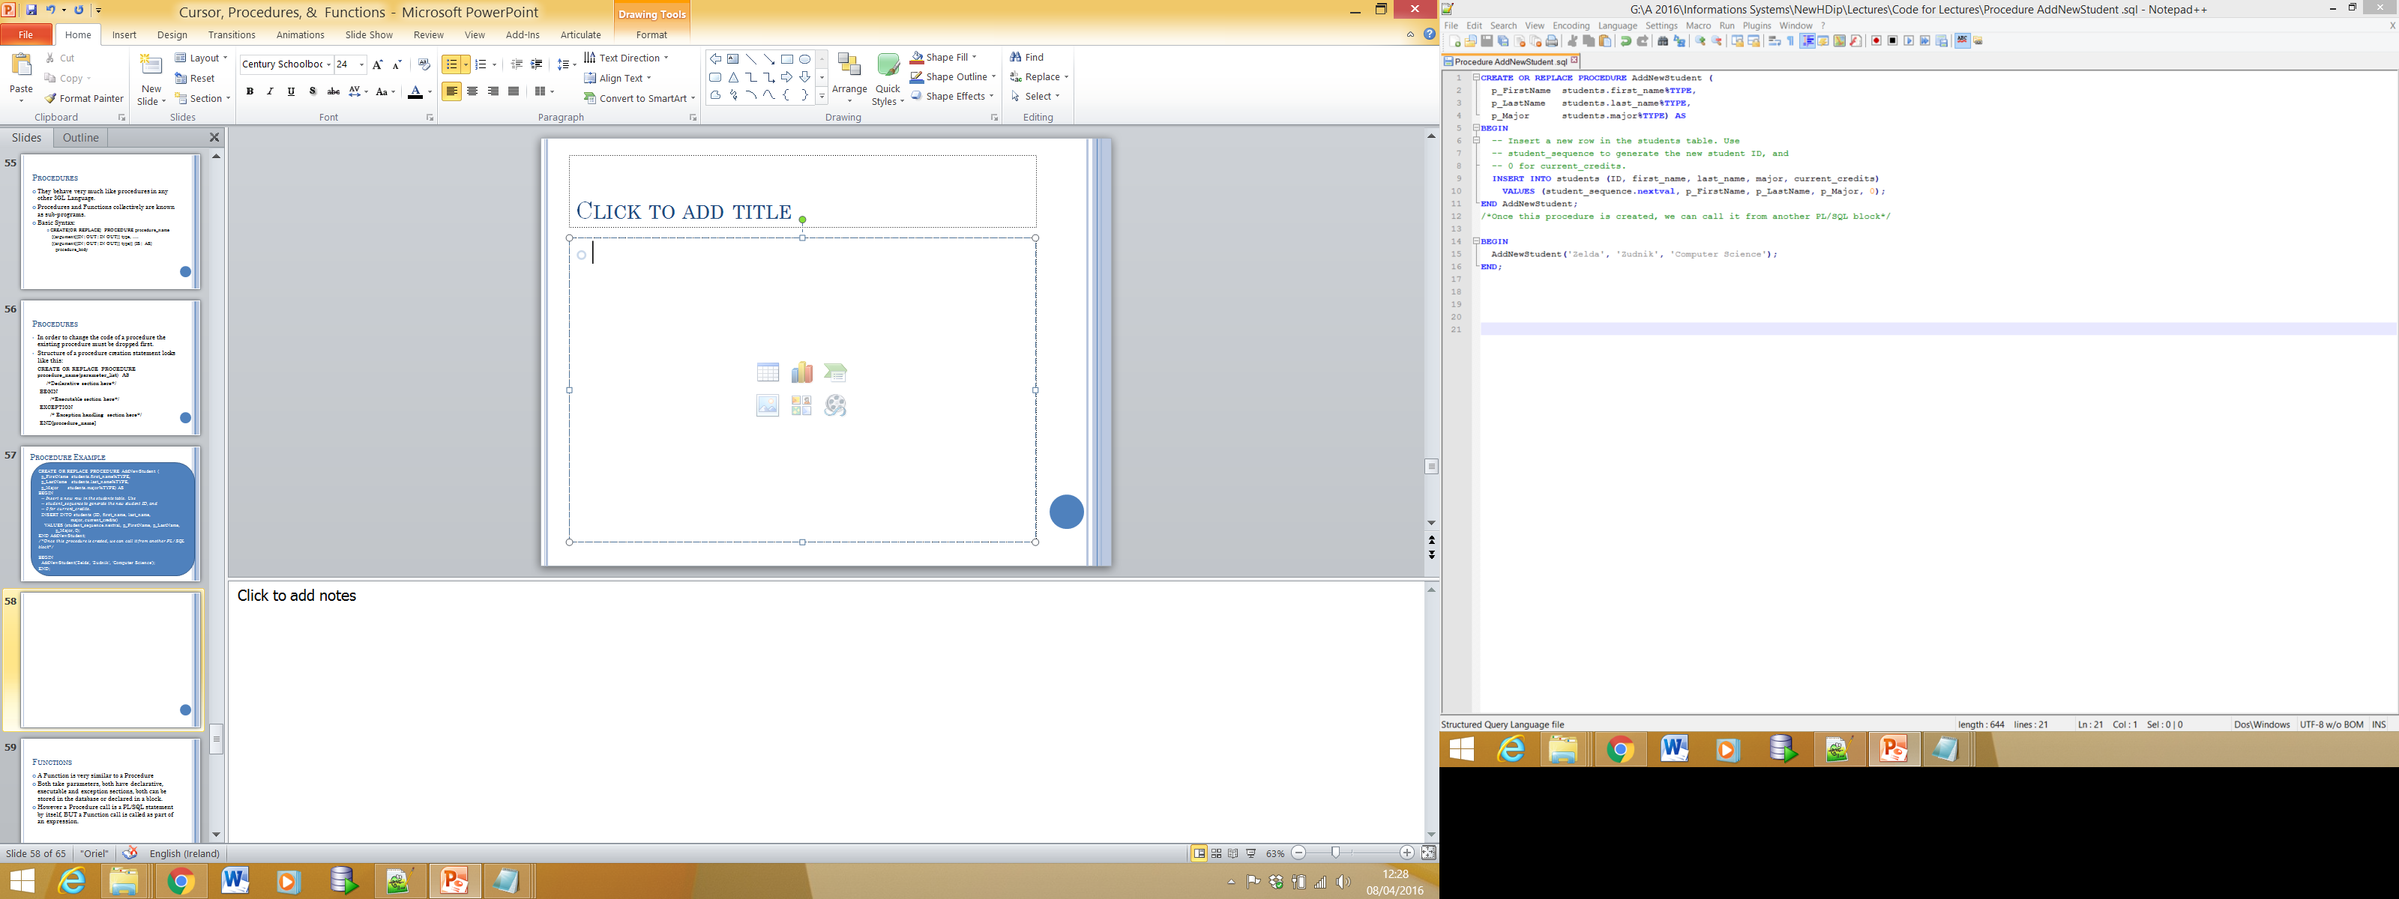
Example 2
IN Parameters

Slide 12
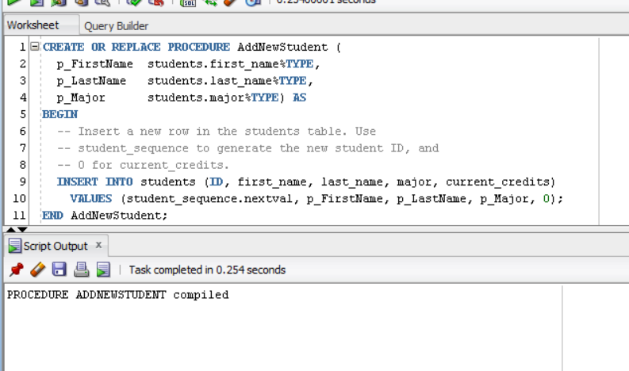
Example 2
Result when executed

Slide 13
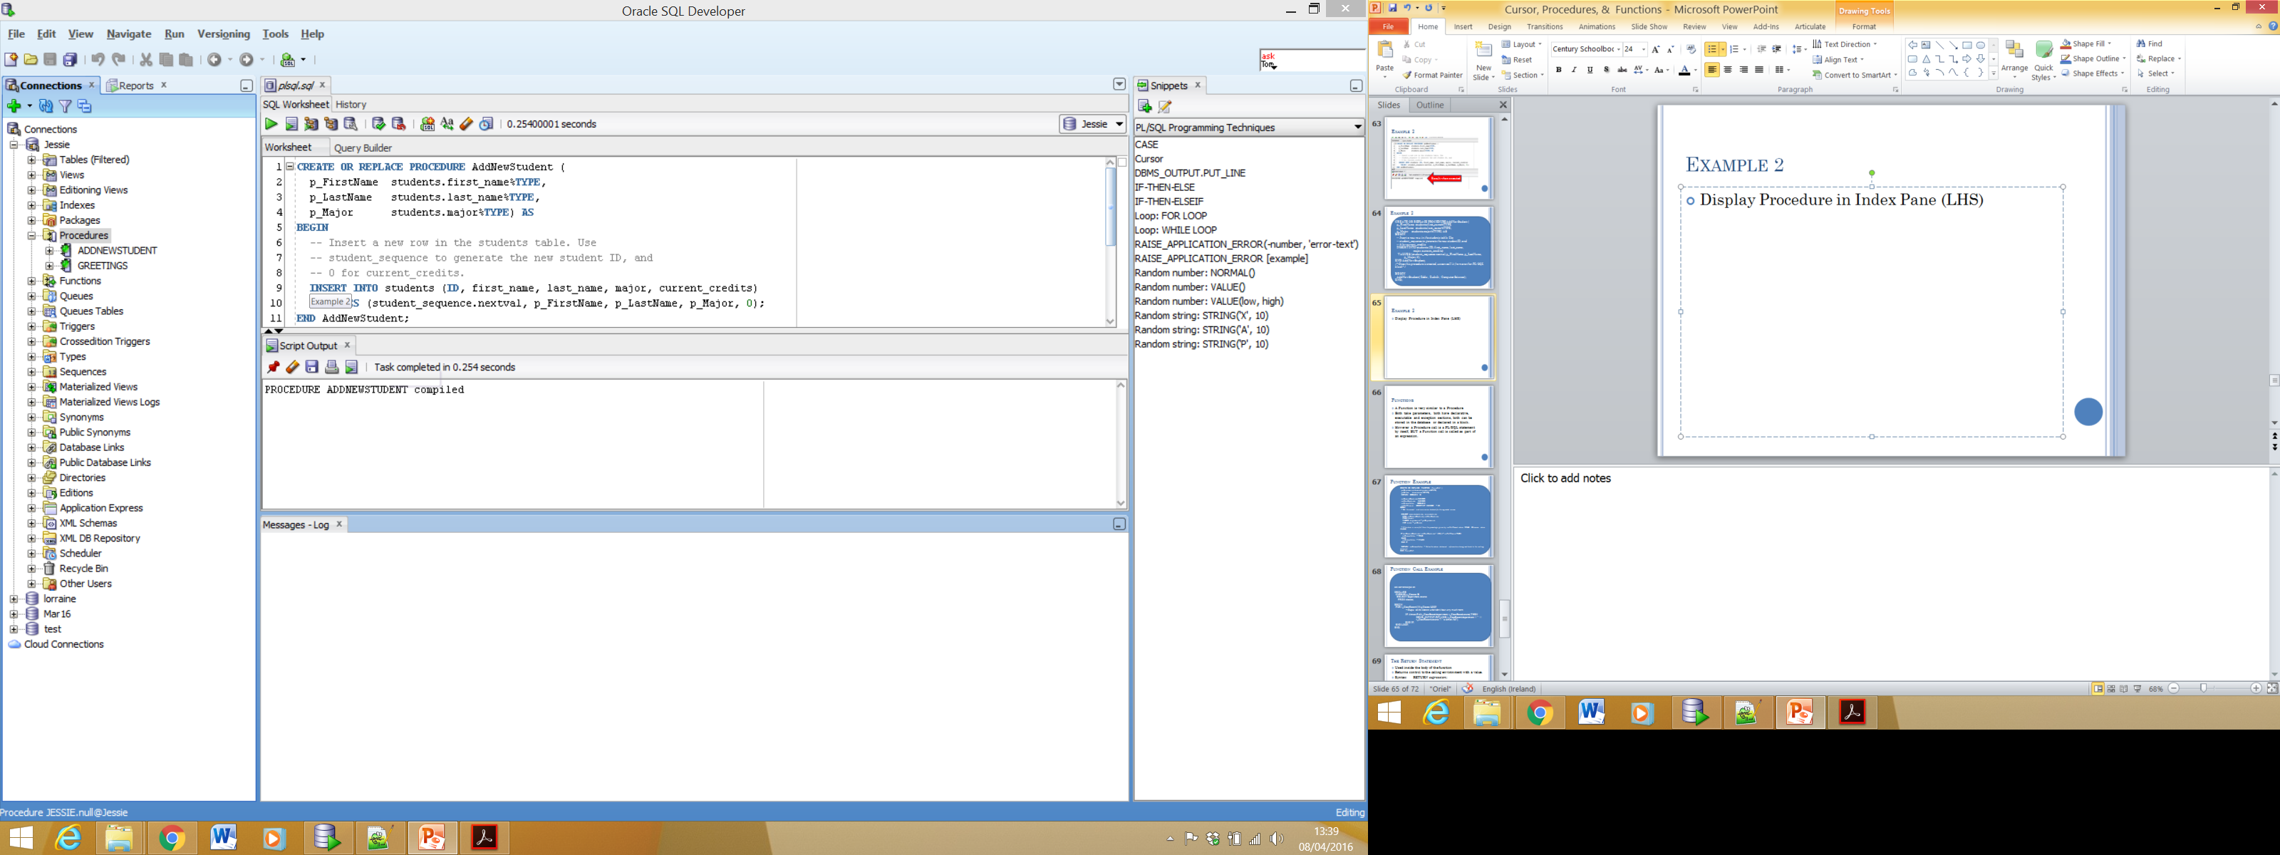
Example 2
Display Procedure in Index Pane (LHS)
Stored Procedure

Slide 14
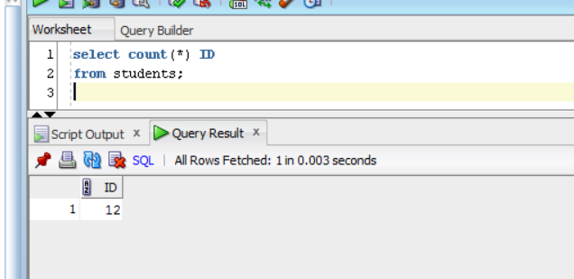
Example 2
Calling Procedure to add a new student.
Note 12 Students currently exist in the students table.

Slide 15
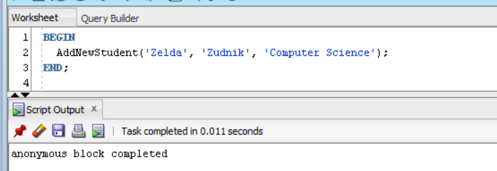
Example 2
Run script to add new student:
BEGIN
AddNewStudent('Zelda', 'Zudnik', 'Computer Science');
END;

Slide 16
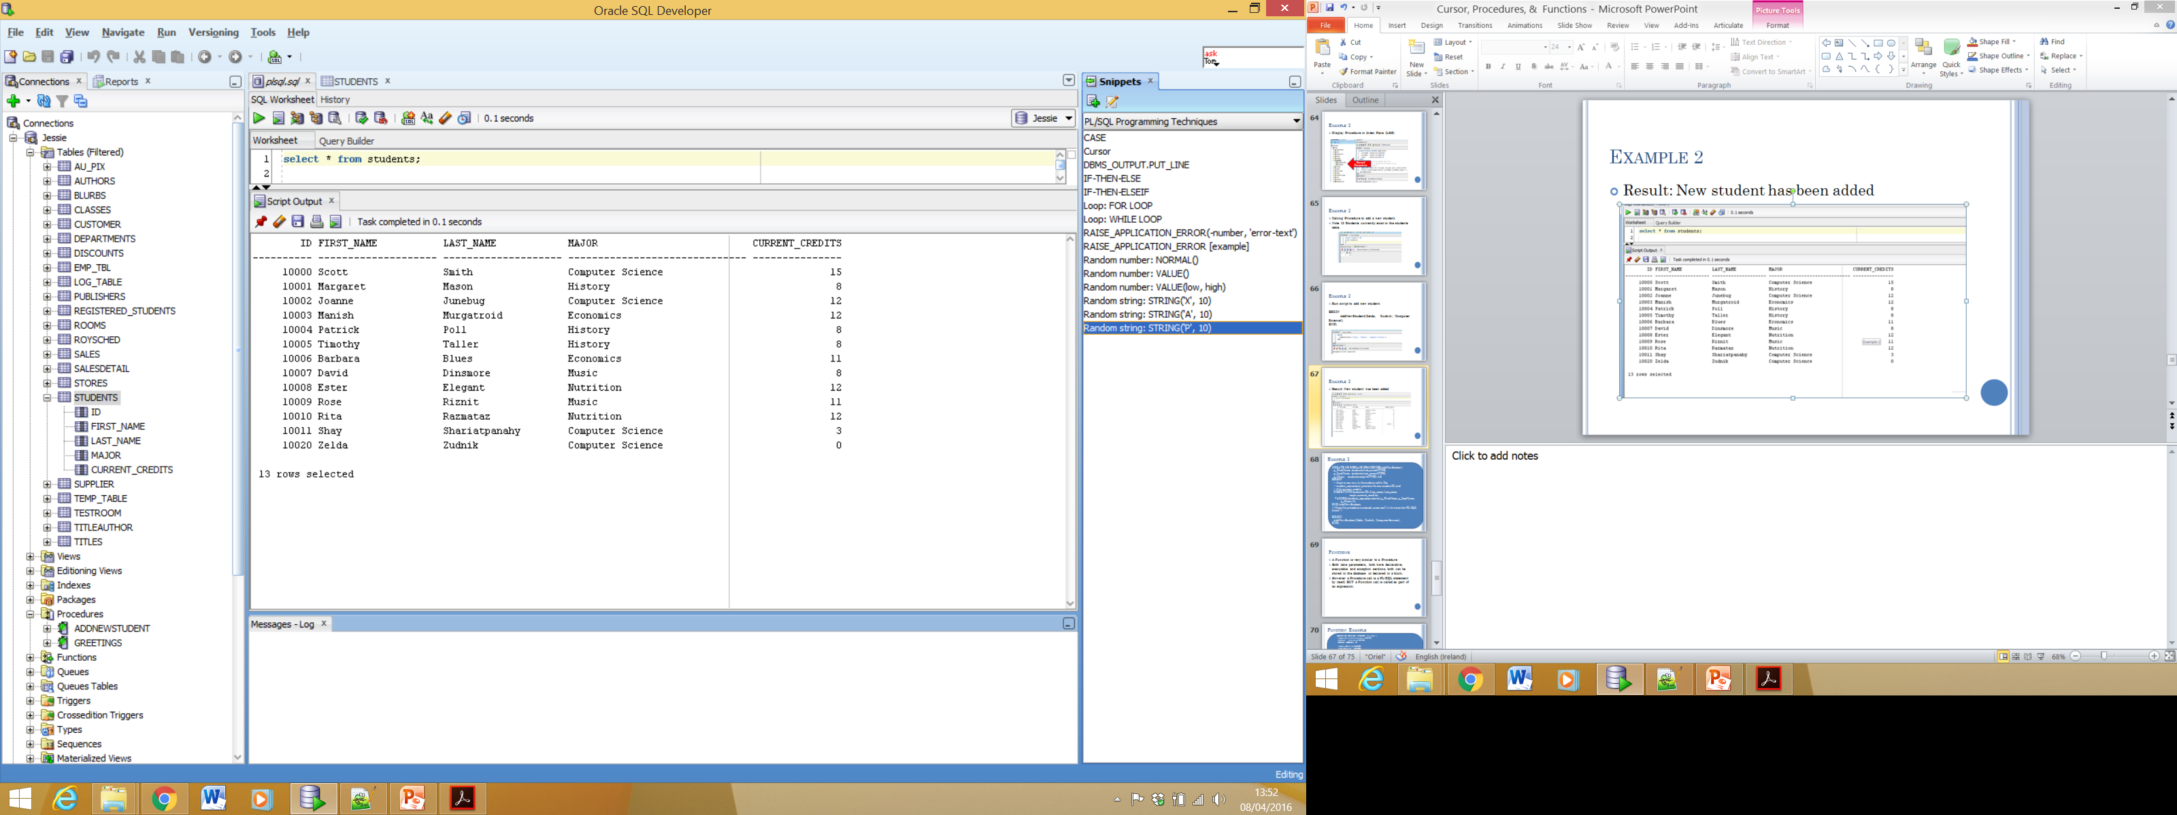
Example 2
Result: New student has been added

Slide 17
Parameter Modes in PL/SQL subprograms
Parameter Mode & Description
IN parameter
An IN parameter lets you pass a value to the subprogram.
It is a read-only parameter.
Inside the subprogram, an IN parameter acts like a constant.
It cannot be assigned a value.
You can pass a constant, literal, initialized variable, or expression as an IN parameter.
You can also initialise it to a default value, however in that case it is omitted from the subprogram call. Parameter are passed by reference.

Slide 18
Parameter Modes in PL/SQL subprograms
Parameter Mode & Description
OUT Parameter
An OUT parameter returns a value to the calling program.
Inside the subprogram, an OUT parameter acts like a variable.
You can change its value and reference the value after assigning it.
The actual parameter must be variable and it is passed by value.

Slide 19
Parameter Modes in PL/SQL subprograms
Parameter Mode & Description
3. IN OUT Parameter
An IN OUT parameter passes an initial value to a subprogram and returns an updated value to the caller.
It can be assigned a value and its value can be read.
The actual parameter corresponding to an IN OUT formal parameter must be a variable, not a constant or an expression.
Formal parameter must be assigned a value. Actual parameter is passed by value.

Slide 20
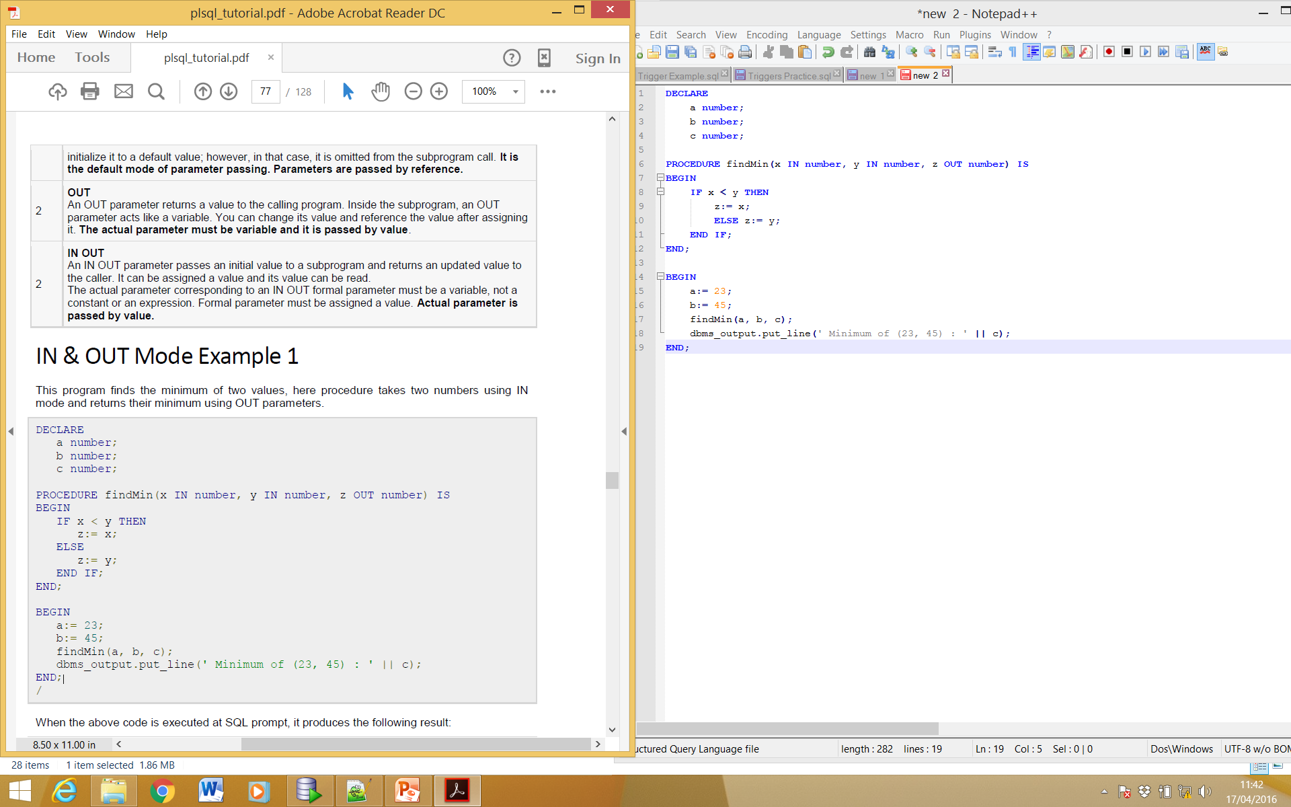
Parameter Modes in PL/SQL subprograms IN & Out Mode Example1
This program finds the minimum of two values, the procedure takes two numbers using IN mode and returns their minimum using OUT parameters.

Slide 21
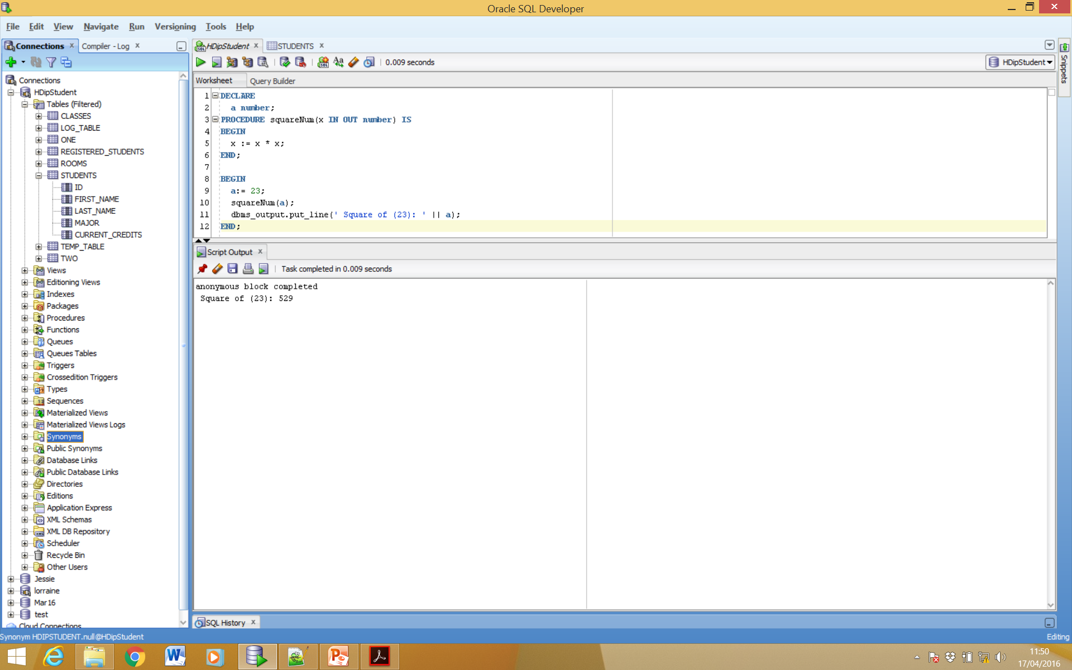
Parameter Modes in PL/SQL subprograms In & OUT Mode Example 2
This procedure computes the square of value of a passed value. This example shows how we can use same parameter to accept a value and then return another result.

Slide 22
Functions

Slide 23
Functions
A Function is very similar to a Procedure
Both take parameters, both have declarative, executable and exception sections, both can be stored in the database or declared in a block.
However a Procedure call is a PL/SQL statement by itself, BUT a Function call is called as part of an expression.
A function returns a value.

Slide 24
Function Example 1
Function syntax:
CREATE [OR REPLACE] FUNCTION function_name
[(parameter_name [IN | OUT | IN OUT] type [, ...])]
RETURN return_datatype
{IS | AS}
BEGIN
< function_body >
END [function_name];

Slide 25
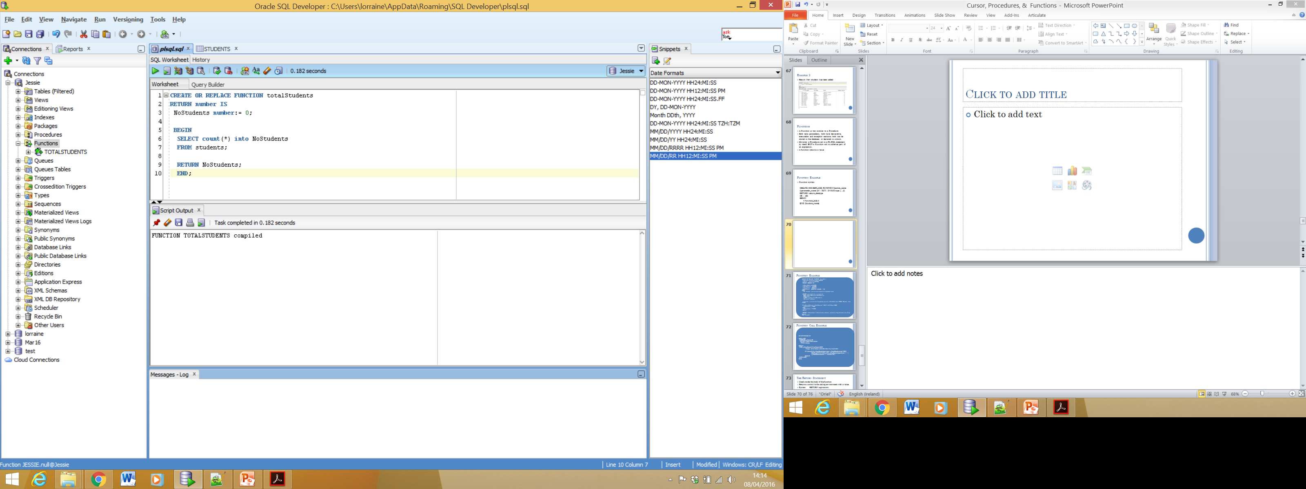
Function Example 1

Slide 26
Function Example 1
While creating a function, you give a definition of what the function has to do. To use a function, you will have to call that function to perform the defined task. When a program calls a function, program control is transferred to the called function.
A called function performs defined task and when its return statement is executed or when it last end statement is reached, it returns program control back to the main program.
To call a function you simply need to pass the required parameters along with function name and if function returns a value then you can store returned value. Following program calls the function totalStudents from an anonymous block:

Slide 27
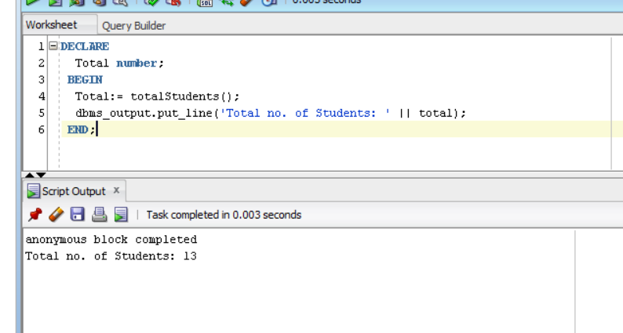
Function Example 1

Slide 28
Function Example 2
The following is one more example which demonstrates Declaring, Defining, and Invoking a Simple PL/SQL Function that computes and returns the maximum of two values.

Slide 29
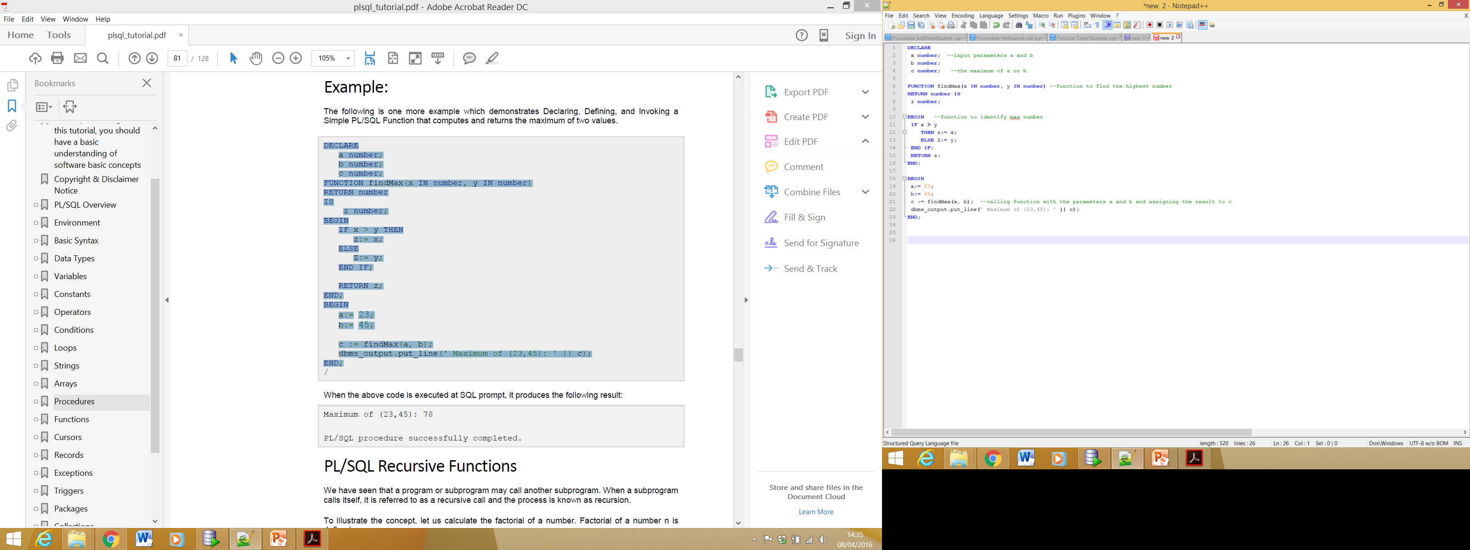
Function Example 2

Slide 30
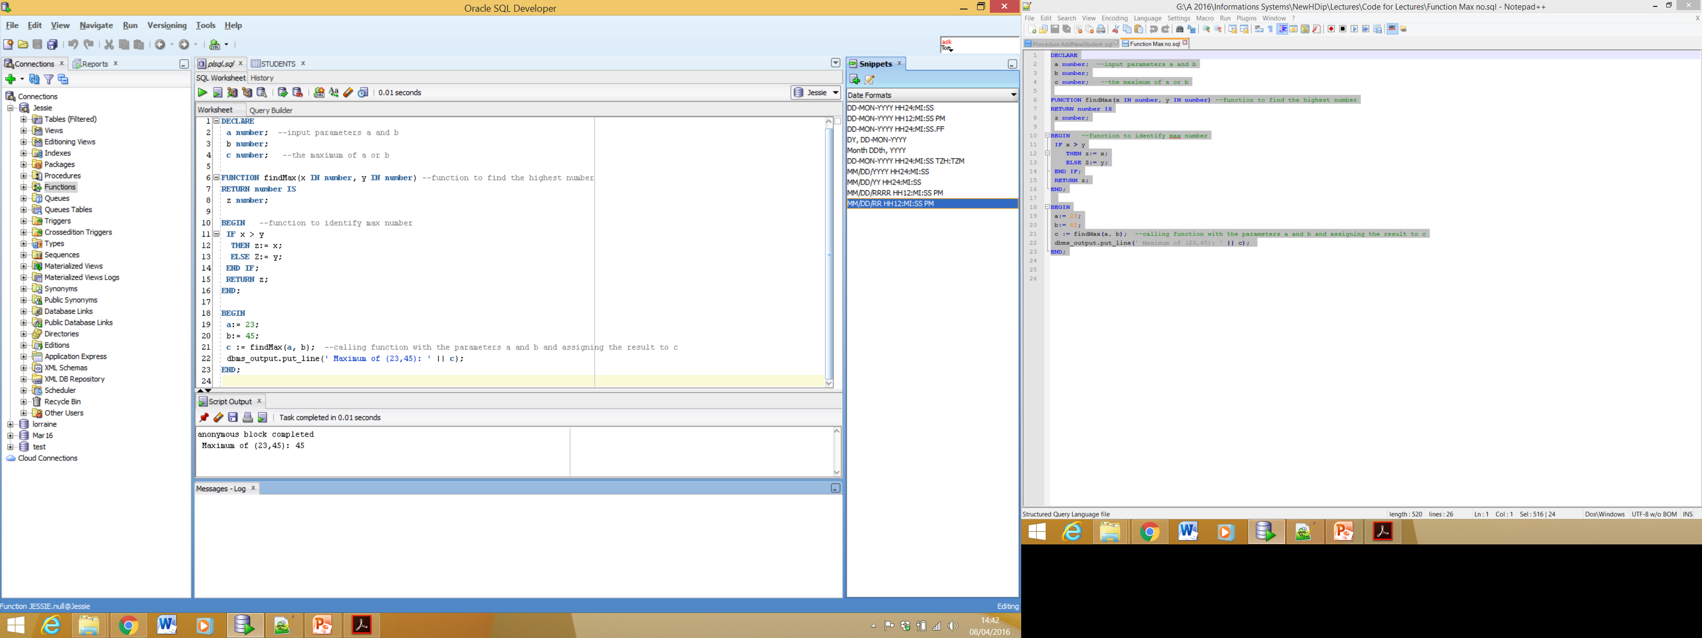
Function Example 2 Output

Slide 31
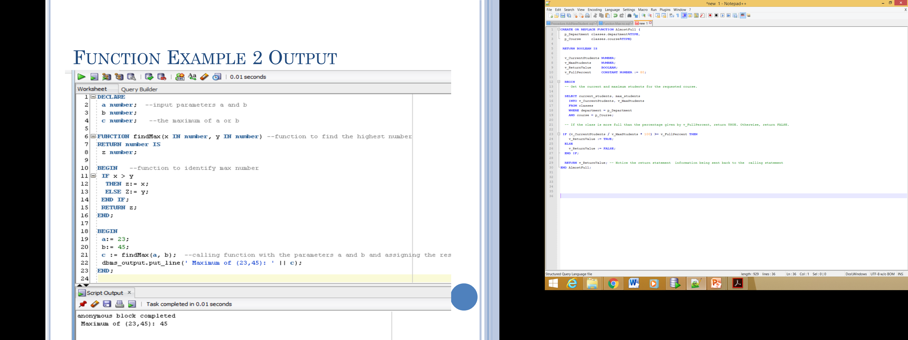
Function Example 3
Notes:
RETURN: Used inside the body of a Function, it returns control to the calling Environment with a value.
Return type MUST be included where it is optional in a procedure.
There can be many RETURN statements in a function although only one of them should be executed.
It is an error for a function to end without executing a RETURN.

Slide 32
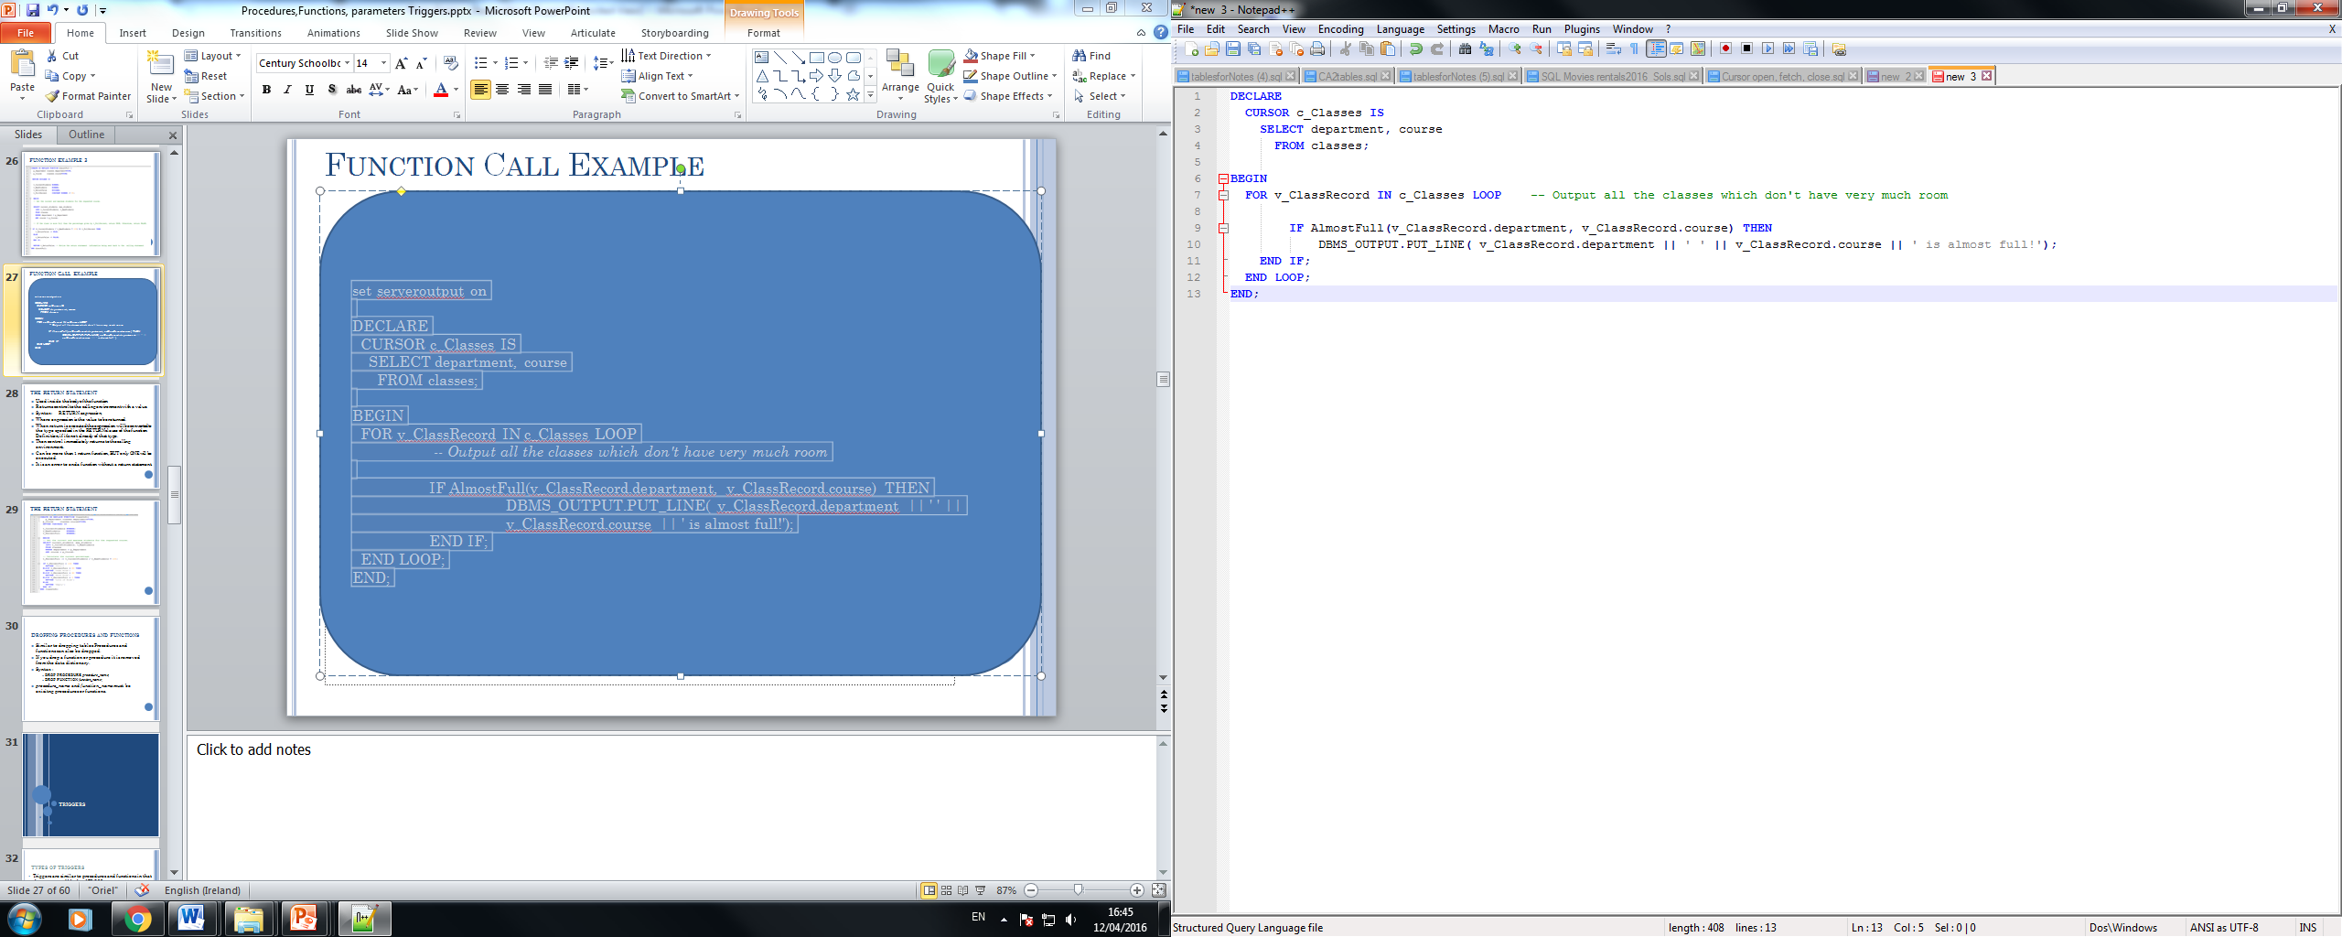
Function Call Example

Slide 33
The Return Statement
Used inside the body of the function
Returns control to the calling environment with a value.
Syntax: RETURN expression;
Where expression is the value to be returned.
When return is executed the expression will be converted to the type specified in the RETURN clause of the function Definition, if it’s not already of that type.
Then control immediately returns to the calling environment.
Can be more than 1 return function, BUT only ONE will be executed.
It is an error to end a function without a return statement.

Slide 34
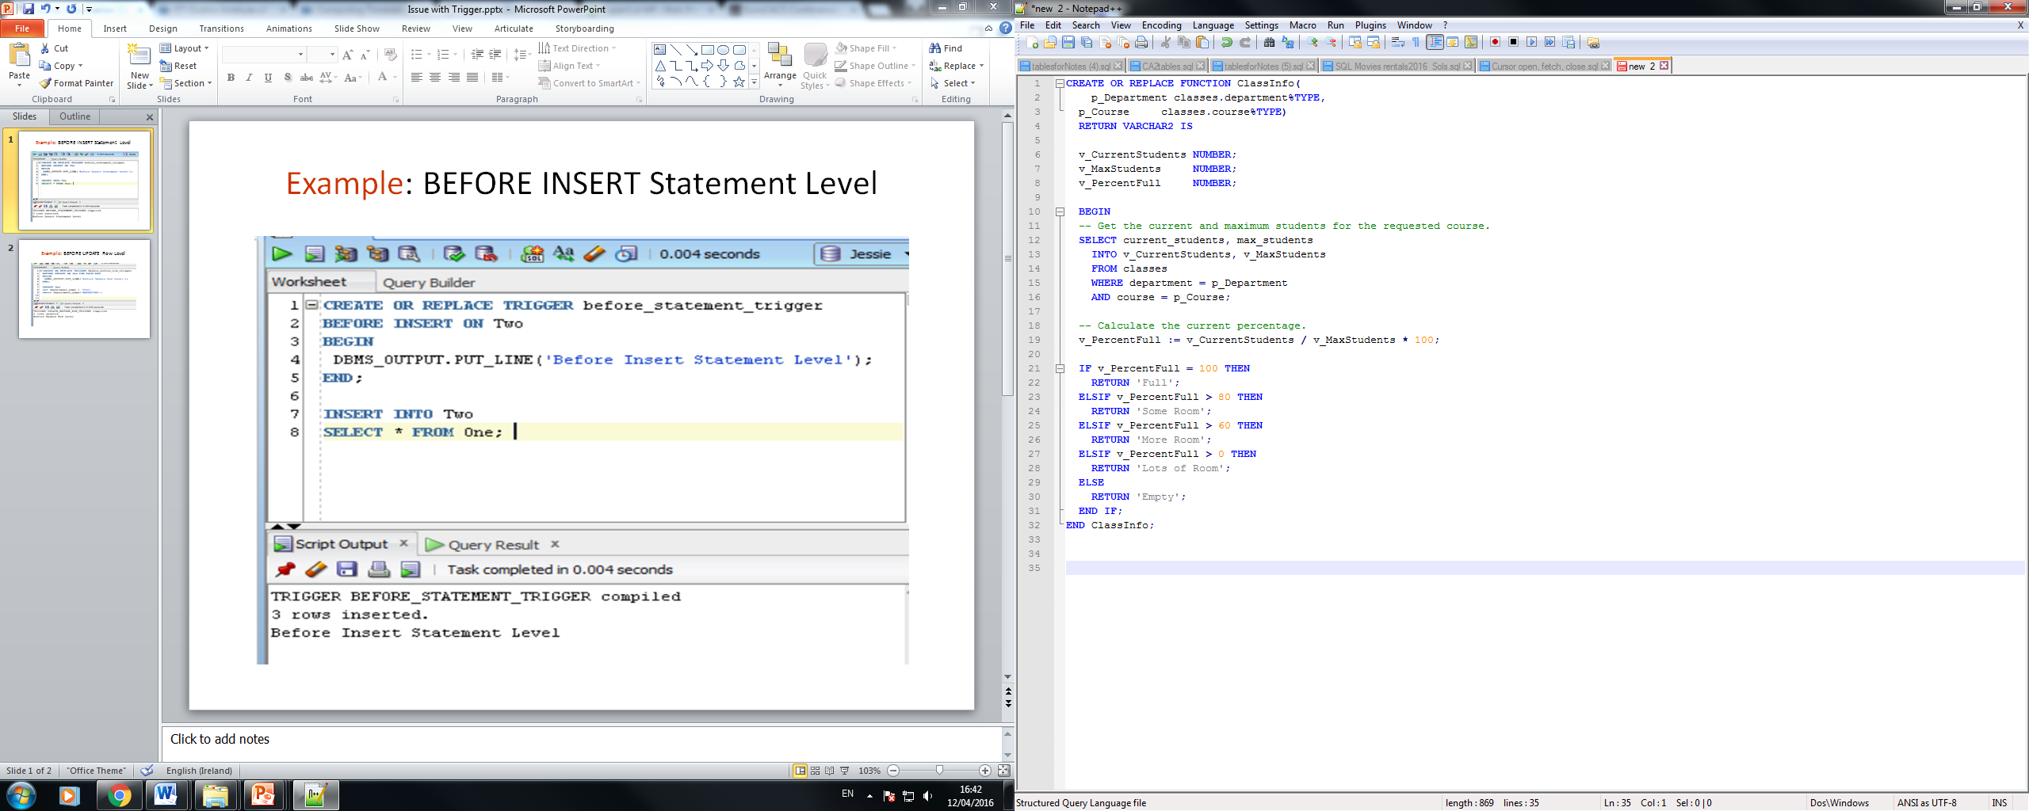
The Return Statement
Notes:
/* Returns 'Full' if the class is completely full,
'Some Room' if the class is over 80% full,
'More Room' if the class is over 60% full,
'Lots of Room' if the class is less than 60% full, and
'Empty' if there are no students registered. */
When used in a function a RETURN statement must have an expression associated with it. Return can also be used in a procedure, however, in this case the return statement has no arguments. This causes control to return to the calling environment immediately.

Slide 35
Dropping Procedures and Functions
Similar to dropping tables Procedures and functions can also be dropped.
If you drop a function or procedure it is removed from the data dictionary.
Syntax :
DROP PROCEDURE procedure_name;
DROP FUNCTION function_name;
procedure_name and function_name must be exisitng procedures or functions.

Slide 36
Triggers

Slide 37
Types of Triggers
Triggers are similar to procedures and functions in that they are named blocks of PL/SQL
Procedures are call explicitly via a procedure call.
Triggers are executed implicitly whenever the triggering event happens AND a trigger does not accept arguments.
The act of executing a trigger is referred to as firing the trigger.
Triggering events include:
DML ( insert, update, delete)
Certain types of views
System Events e.g DB startup/Shutdown ( Oracle 8i and after)
Certain kinds of DDL

Slide 38
Uses Of Triggers
Triggers are used for many things including:
Maintaining complex integrity constraints, those not possible through declarative constraints at table creation.
Auditing information in a table by recording the changes made and who made them.
Automatically signalling other programs that action needs to take place when changes are made to a table.
Publishing information about various Database events.

Slide 39
DML Triggers
A DML Trigger is fired by a DML statement and the type of statement determines the type of DML Trigger.
These triggers can be fired BEFORE or AFTER the operation
They can also fire on ROW or STATEMENT operations

Slide 40
Creating Triggers
Regardless of the type of Trigger all triggers are created using the same Syntax:
CREATE [OR REPLACE ] TRIGGER trigger_name
{BEFORE | AFTER | INSTEAD OF } {INSERT [OR] | UPDATE [OR] | DELETE}
[OF col_name]
ON table_name
[REFERENCING OLD AS o NEW AS n] [FOR EACH ROW]
WHEN (condition)
DECLARE
Declaration-statements
BEGIN
Executable-statements
EXCEPTION
Exception-handling-statements
END;
Name of Trigger
Notes:
CREATE [OR REPLACE] TRIGGER trigger_name: Creates or replaces an existing trigger with the trigger_name.
• {BEFORE | AFTER | INSTEAD OF}: This specifies when the trigger would be executed. The INSTEAD OF clause is used for creating trigger on a view.
• {INSERT [OR] | UPDATE [OR] | DELETE}: This specifies the DML operation.
• [OF col_name]: This specifies the column name that would be updated.
• [ON table_name]: This specifies the name of the table associated with the trigger.
• [REFERENCING OLD AS o NEW AS n]: This allows you to refer new and old values for various DML statements, like INSERT, UPDATE, and DELETE.
• [FOR EACH ROW]: This specifies a row level trigger, i.e., the trigger would be executed for each row being affected. Otherwise the trigger will execute just once when the SQL statement is executed, which is called a table level trigger.
• WHEN (condition): This provides a condition for rows for which the trigger would fire. This clause is valid only for row level triggers.
NOTE : Trigger body cannot be bigger than 32K, if bigger move code out into procedure/function and call from trigger.
Triggers called a lot so more efficient to keep code small.

Slide 41
Creating Triggers
Regardless of the type of Trigger all triggers are created using the same Syntax:
CREATE [OR REPLACE ] TRIGGER trigger_name
{BEFORE | AFTER | INSTEAD OF } {INSERT [OR] | UPDATE [OR] | DELETE}
[OF col_name]
ON table_name
[REFERENCING OLD AS o NEW AS n] [FOR EACH ROW]
WHEN (condition)
DECLARE
Declaration-statements
BEGIN
Executable-statements
EXCEPTION
Exception-handling-statements
END;
When trigger should be executed
Notes:
Trigger_name is the name of the trigger
Triggering_event specifies the event that fires the trigger
Trigger_body is the main code for the trigger.
Referencing clause – is used to refer to the data in the row currently being modified by a different name
Trigger- condidition – in there when clause, if present, is evaluated first, and the body of the trigger is executed only when this condition evaluates to TRUE
NOTE : Trigger body cannotbe bigger than32K, if bigger move code out into procedure/function and call from trigger. Triggers called a lot so more efficient to keep code small.

Slide 42
Creating Triggers
Regardless of the type of Trigger all triggers are created using the same Syntax:
CREATE [OR REPLACE ] TRIGGER trigger_name
{BEFORE | AFTER | INSTEAD OF } {INSERT [OR] | UPDATE [OR] | DELETE}
[OF col_name]
ON table_name
[REFERENCING OLD AS o NEW AS n] [FOR EACH ROW]
WHEN (condition)
DECLARE
Declaration-statements
BEGIN
Executable-statements
EXCEPTION
Exception-handling-statements
END;
Column and table associated with trigger
Notes:
Trigger_name is the name of the trigger
Triggering_event specifies the event that fires the trigger
Trigger_body is the main code for the trigger.
Referencing clause – is used to refer to the data in the row currently being modified by a different name
Trigger- condidition – in there when clause, if present, is evaluated first, and the body of the trigger is executed only when this condition evaluates to TRUE
NOTE : Trigger body cannotbe bigger than32K, if bigger move code out into procedure/function and call from trigger. Triggers called a lot so more efficient to keep code small.

Slide 43
Creating Triggers
Regardless of the type of Trigger all triggers are created using the same Syntax:
CREATE [OR REPLACE ] TRIGGER trigger_name
{BEFORE | AFTER | INSTEAD OF } {INSERT [OR] | UPDATE [OR] | DELETE}
[OF col_name]
ON table_name
[REFERENCING OLD AS o NEW AS n] [FOR EACH ROW]
WHEN (condition)
DECLARE
Declaration-statements
BEGIN
Executable-statements
EXCEPTION
Exception-handling-statements
END;
Allows you to refer new and old values for various DML statements
Notes:
Trigger_name is the name of the trigger
Triggering_event specifies the event that fires the trigger
Trigger_body is the main code for the trigger.
Referencing clause – is used to refer to the data in the row currently being modified by a different name
Trigger- condidition – in there when clause, if present, is evaluated first, and the body of the trigger is executed only when this condition evaluates to TRUE
NOTE : Trigger body cannotbe bigger than32K, if bigger move code out into procedure/function and call from trigger. Triggers called a lot so more efficient to keep code small.

Slide 44
Creating Triggers
Regardless of the type of Trigger all triggers are created using the same Syntax:
CREATE [OR REPLACE ] TRIGGER trigger_name
{BEFORE | AFTER | INSTEAD OF } {INSERT [OR] | UPDATE [OR] | DELETE}
[OF col_name]
ON table_name
[REFERENCING OLD AS o NEW AS n] [FOR EACH ROW]
WHEN (condition)
DECLARE
Declaration-statements
BEGIN
Executable-statements
EXCEPTION
Exception-handling-statements
END;
Row Level Trigger
Notes:
Trigger_name is the name of the trigger
Triggering_event specifies the event that fires the trigger
Trigger_body is the main code for the trigger.
Referencing clause – is used to refer to the data in the row currently being modified by a different name
Trigger- condidition – in there when clause, if present, is evaluated first, and the body of the trigger is executed only when this condition evaluates to TRUE
NOTE : Trigger body cannotbe bigger than32K, if bigger move code out into procedure/function and call from trigger. Triggers called a lot so more efficient to keep code small.

Slide 45
Creating Triggers
Regardless of the type of Trigger all triggers are created using the same Syntax:
CREATE [OR REPLACE ] TRIGGER trigger_name
{BEFORE | AFTER | INSTEAD OF } {INSERT [OR] | UPDATE [OR] | DELETE}
[OF col_name]
ON table_name
[REFERENCING OLD AS o NEW AS n] [FOR EACH ROW]
WHEN (condition)
DECLARE
Declaration-statements
BEGIN
Executable-statements
EXCEPTION
Exception-handling-statements
END;
Condition for rows which trigger will fire
Notes:
Trigger_name is the name of the trigger
Triggering_event specifies the event that fires the trigger
Trigger_body is the main code for the trigger.
Referencing clause – is used to refer to the data in the row currently being modified by a different name
Trigger- condition – in there when clause, if present, is evaluated first, and the body of the trigger is executed only when this condition evaluates to TRUE
NOTE : Trigger body cannotbe bigger than32K, if bigger move code out into procedure/function and call from trigger. Triggers called a lot so more efficient to keep code small.

Slide 46
Creating Triggers
Regardless of the type of Trigger all triggers are created using the same Syntax:
CREATE [OR REPLACE ] TRIGGER trigger_name
{BEFORE | AFTER | INSTEAD OF } {INSERT [OR] | UPDATE [OR] | DELETE}
[OF col_name]
ON table_name
[REFERENCING OLD AS o NEW AS n] [FOR EACH ROW]
WHEN (condition)
DECLARE
Declaration-statements
BEGIN
Executable-statements
EXCEPTION
Exception-handling-statements
END;
Notes:
Trigger_name is the name of the trigger
Triggering_event specifies the event that fires the trigger
Trigger_body is the main code for the trigger.
Referencing clause – is used to refer to the data in the row currently being modified by a different name
Trigger- condidition – in there when clause, if present, is evaluated first, and the body of the trigger is executed only when this condition evaluates to TRUE
NOTE : Trigger body cannotbe bigger than32K, if bigger move code out into procedure/function and call from trigger. Triggers called a lot so more efficient to keep code small.

Slide 47
DML Trigger Example
CREATE OR REPLACE TRIGGER UpdateMajorStats
AFTER INSERT OR DELETE OR UPDATE ON students
DECLARE
CURSOR c_Statistics IS
SELECT major, COUNT(*) total_students,
SUM(current_credits) total_credits
FROM students
GROUP BY major;
BEGIN
FOR v_StatsRecord in c_Statistics LOOP
INSERT INTO major_stats (major, total_credits, total_students)
VALUES (v_StatsRecord.major, v_StatsRecord.total_credits,
v_StatsRecord.total_students);
END LOOP;
END UpdateMajorStats;
CREATE TABLE major_stats (
major VARCHAR2(30),
total_credits NUMBER,
total_students NUMBER);
Notes:
DELETE - /* First delete from major_stats. This will clear the statistics, and is necessary to account for the deletion of all students in a given major. */
FOR LOOP - /* Now loop through each major, and insert the appropriate row into major_stats. */
TRIGGER - /* Keeps the major_stats table up-to-date with changes made to the students table. */
A statement trigger can be fired for more then one type of triggering statement. This example is fired on INSERT, UPDATE or DELETE
The triggering event specifies one or more of the DML operations that should fire the trigger.

Slide 48
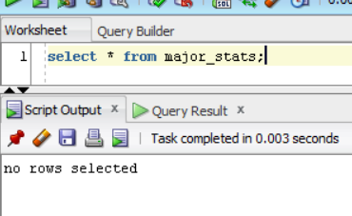
DML Trigger Example check contents of major_stats table before inserting records following creation of trigger

Slide 49
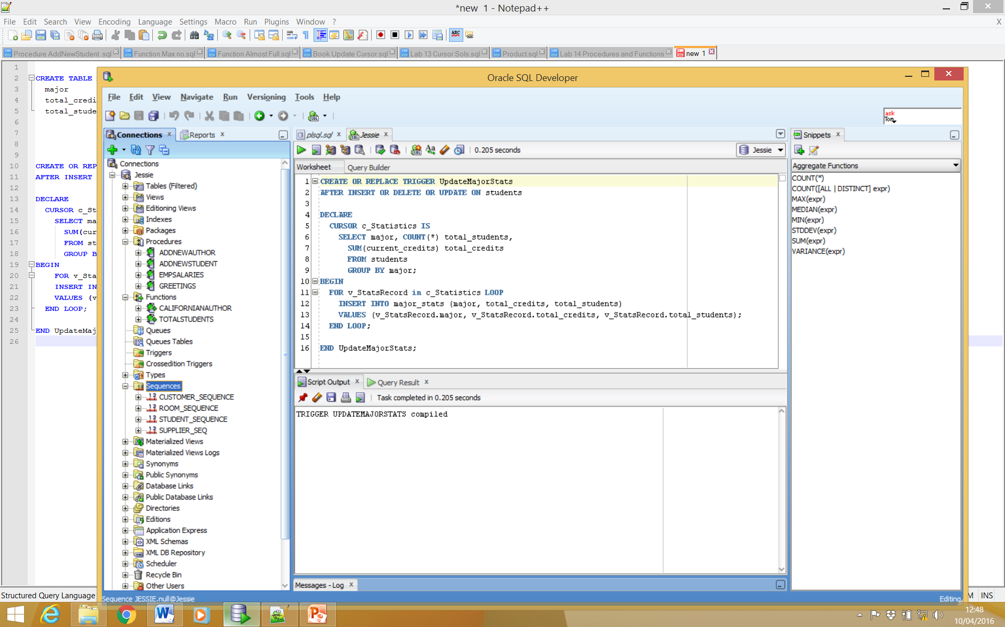
DML Trigger Example create trigger

Slide 50
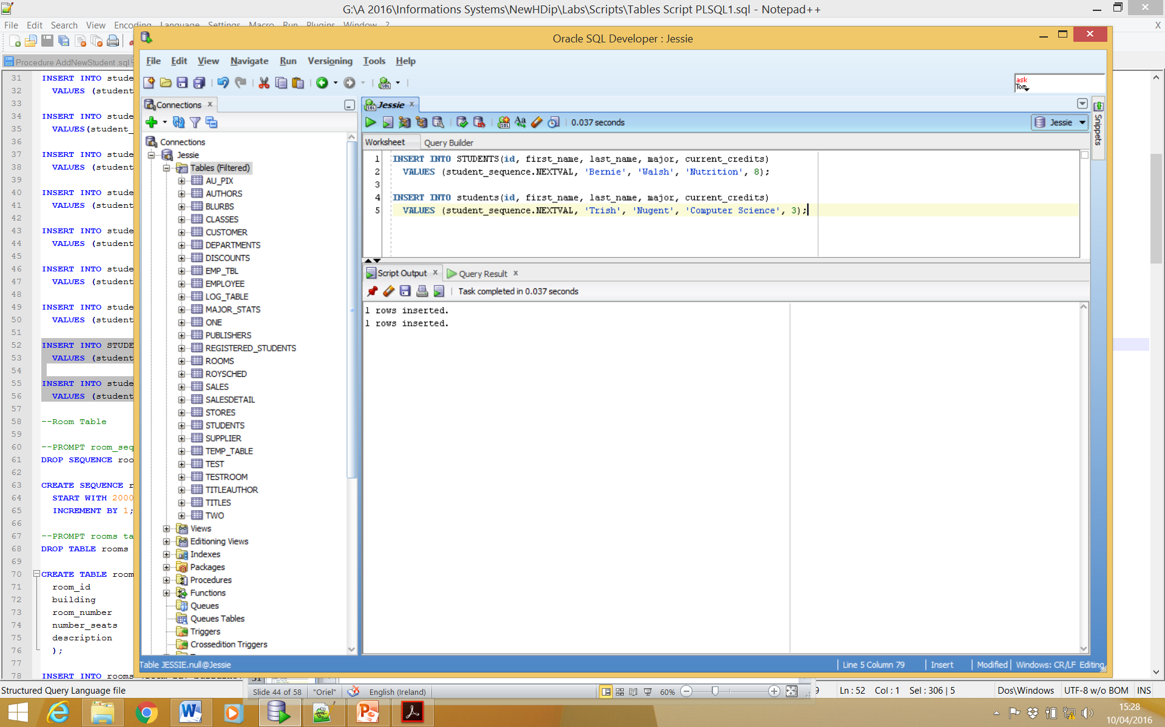
DML Trigger Example Insert new records To Fire Trigger

Slide 51
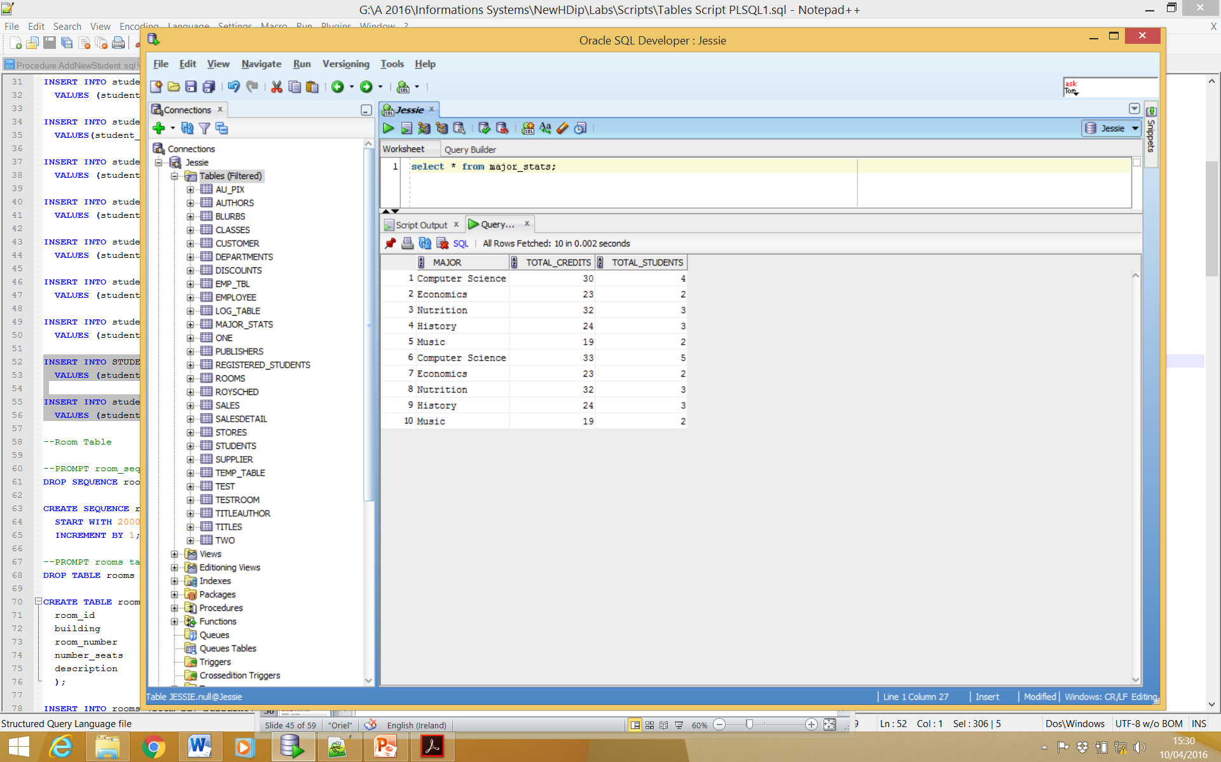
DML Trigger Example Table updated by trigger executing

Slide 52
More on DML Triggers
Category | Values | Comments
Statement | INSERT, UPDATE or DELETE | Defines which kind of statement causes the trigger to fire.
Timing | BEFORE or AFTER | Defines whether the trigger fires before or after the statement is executed.
Level | ROW or STATEMENT | If the trigger is a row level trigger, it fires once for each row affected by the triggering statement. If the trigger is a statement level trigger, it fires once, either before or after the statement. A row level trigger is identified by the FOR EACH ROW clause in the trigger definition.

Slide 53
The WHEN Clause
The WHEN clause is valid for row level triggers only. If present the trigger body will be executed only for those rows that meet the condition specified by the when clause.
CREATE OR REPLACE TRIGGER CheckCredits
BEFORE INSERT OR UPDATE OF current_credits ON students
FOR EACH ROW
WHEN (new.current_credits>20)
BEGIN
/* Trigger body goes here*/
END

Slide 54
ENABLE/DISABLE Triggers
When a Trigger is enabled it fires when the triggering event occurs. We can explicitly set a trigger to be enabled:
ALTER TRIGGER trigger_name ENABLE;
We can also explicitly disable a trigger:
ALTER TRIGGER trigger_name DISABLE;

Slide 55
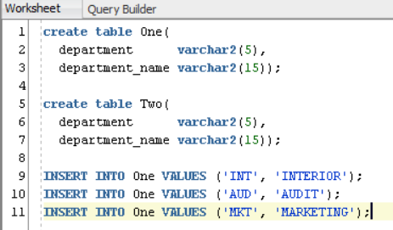
Examples: Sample Table

Slide 56
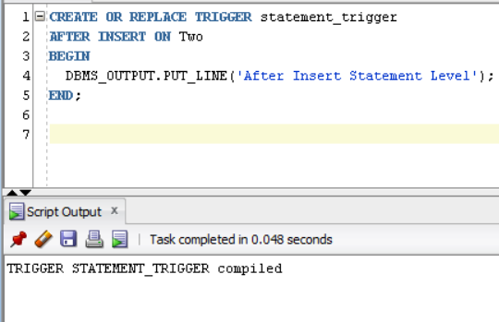
Example: AFTER Statement Level

Slide 57
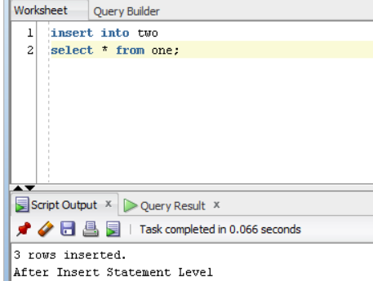
Example: AFTER Statement Level

Slide 58
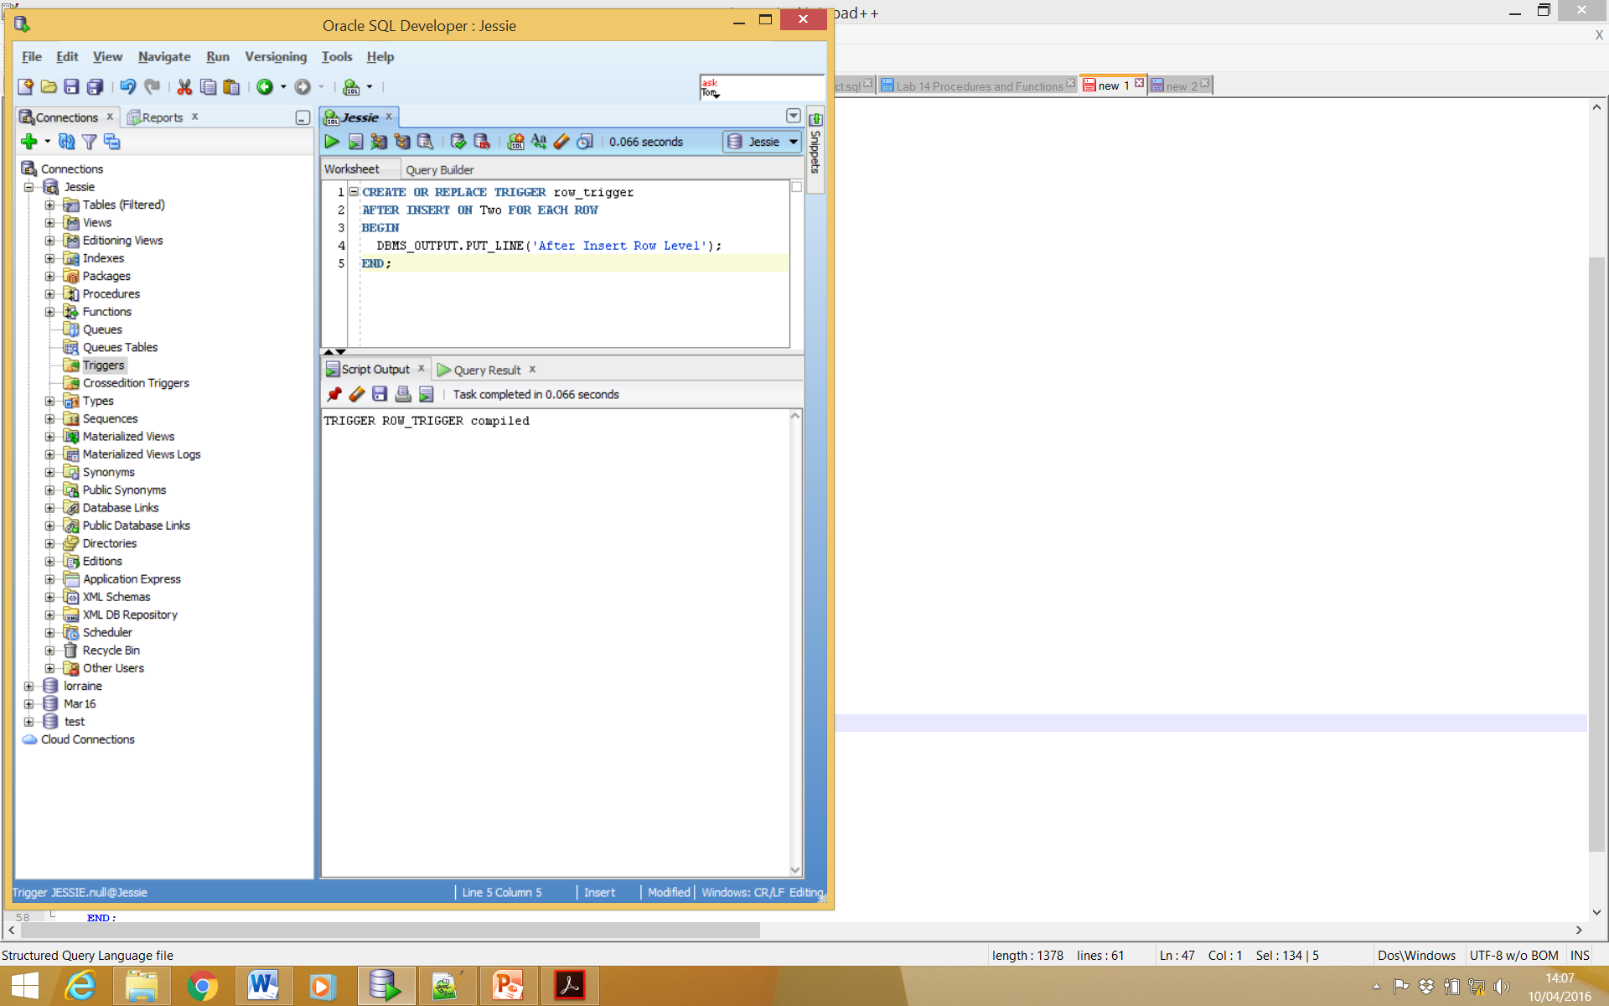
Example: AFTER Row Level

Slide 59
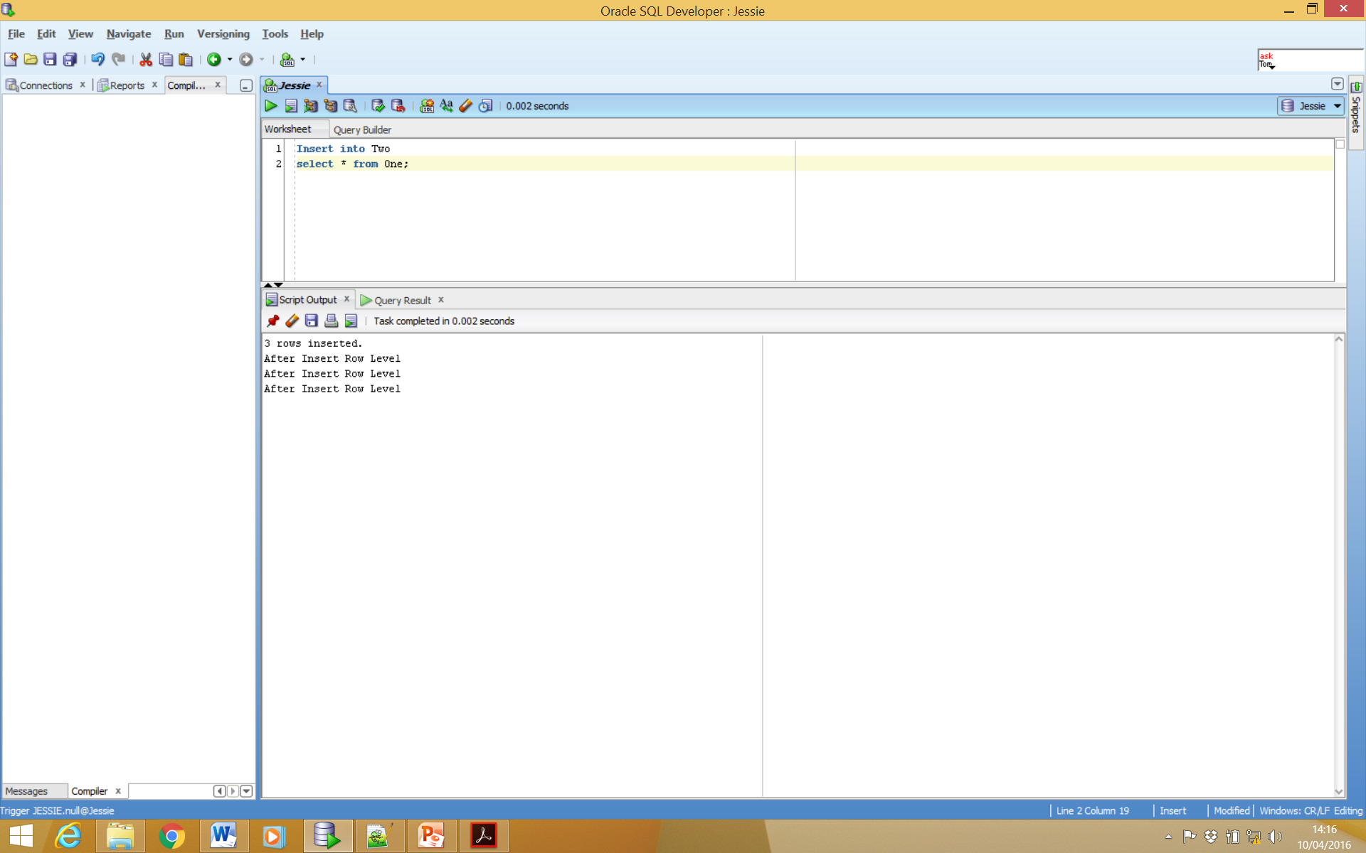
Example: AFTER Row Level

Slide 60
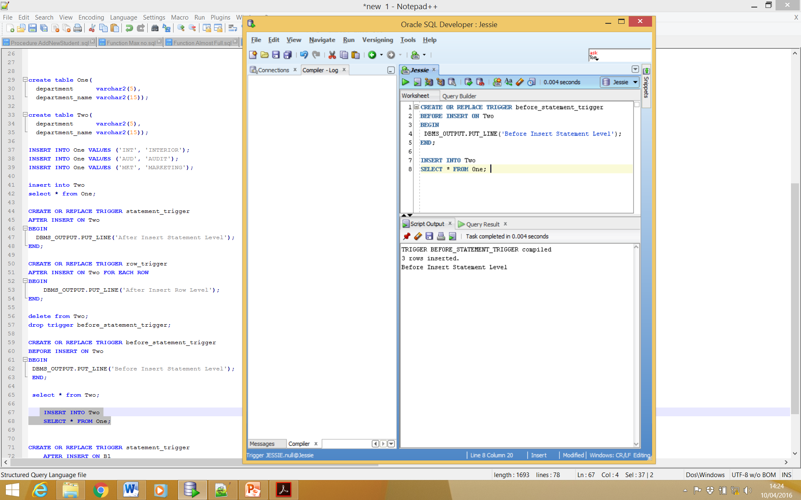
Example: BEFORE INSERT Statement Level

Slide 61
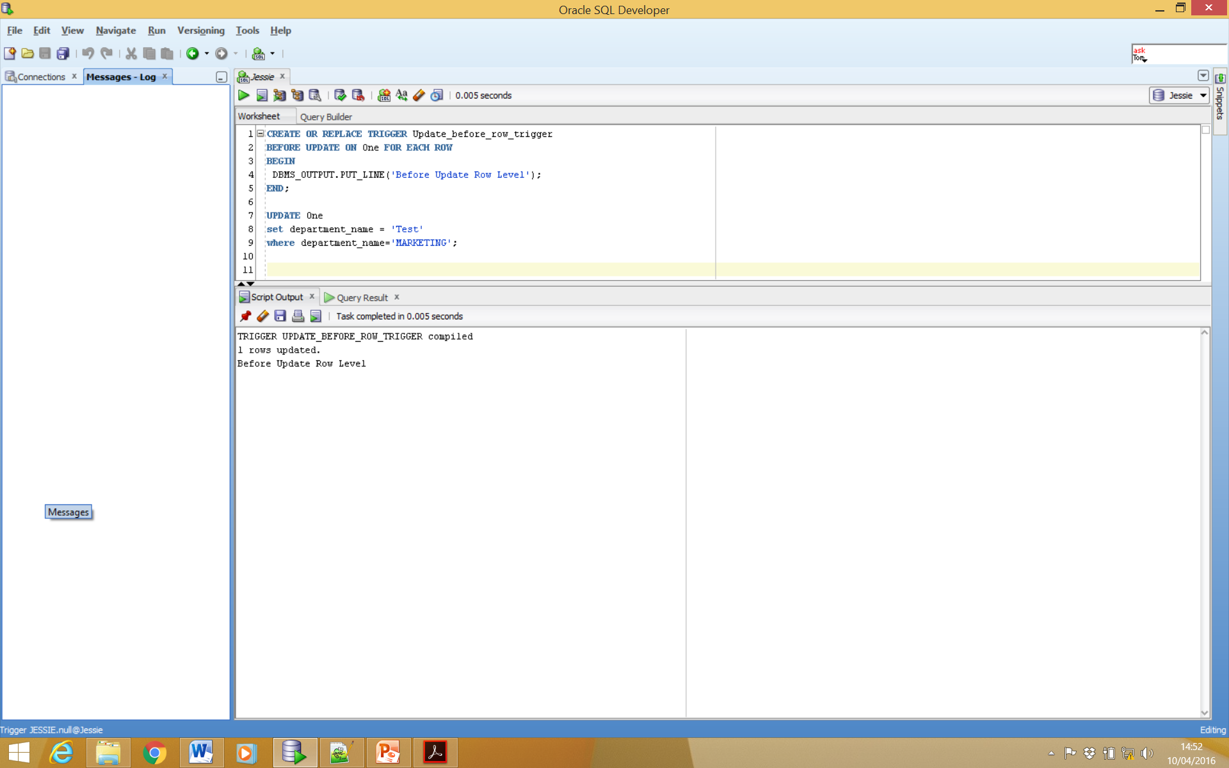
Example: BEFORE UPDATE Row Level

Slide 62
Note: output after before command
3 Rows Inserted
1 Row Updated

Slide 63
Note: output after before command
Ideally we wish to stop something happening when using the trigger before command i.e. alert user.
This can be accomplished by inputting the following command:
Raise_application_error (-20343, ‘Before Trigger’);

Slide 64
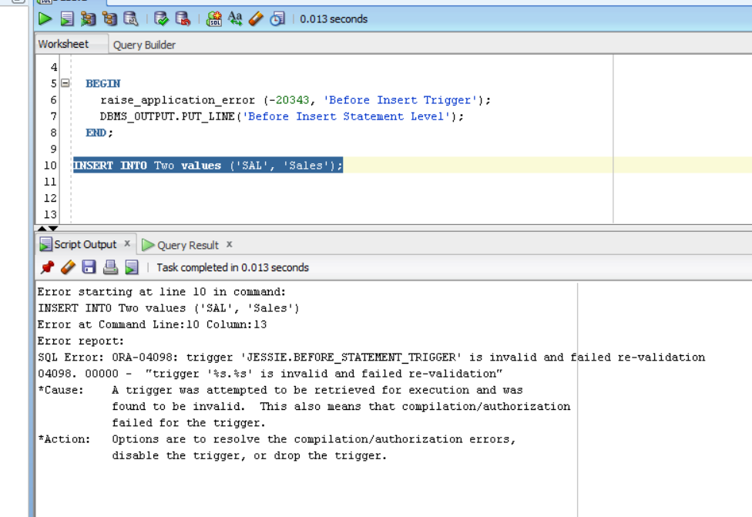
Note: output after before command

Slide 65
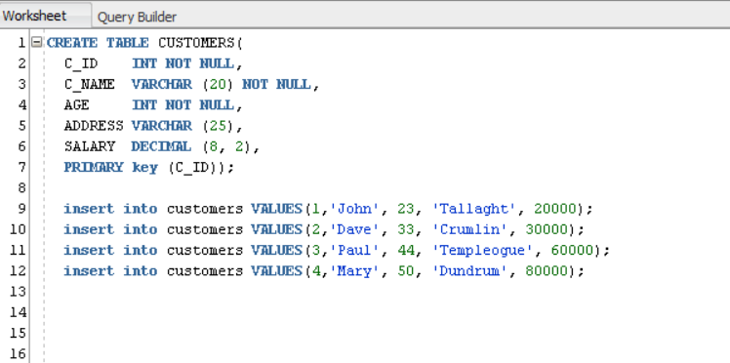
Trigger Sample

Slide 66
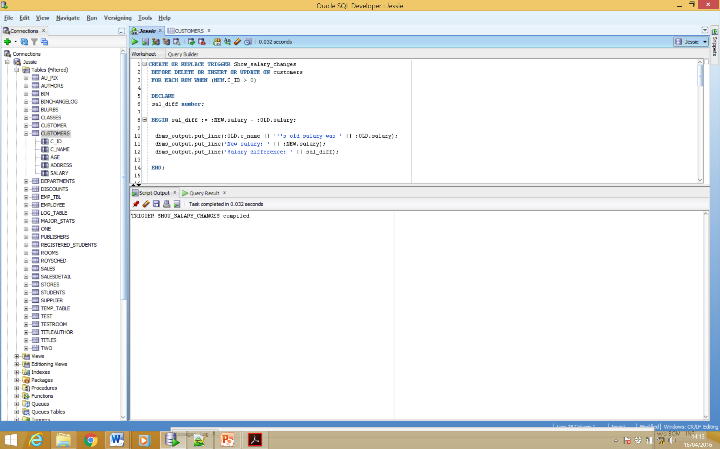
Trigger Sample

Slide 67
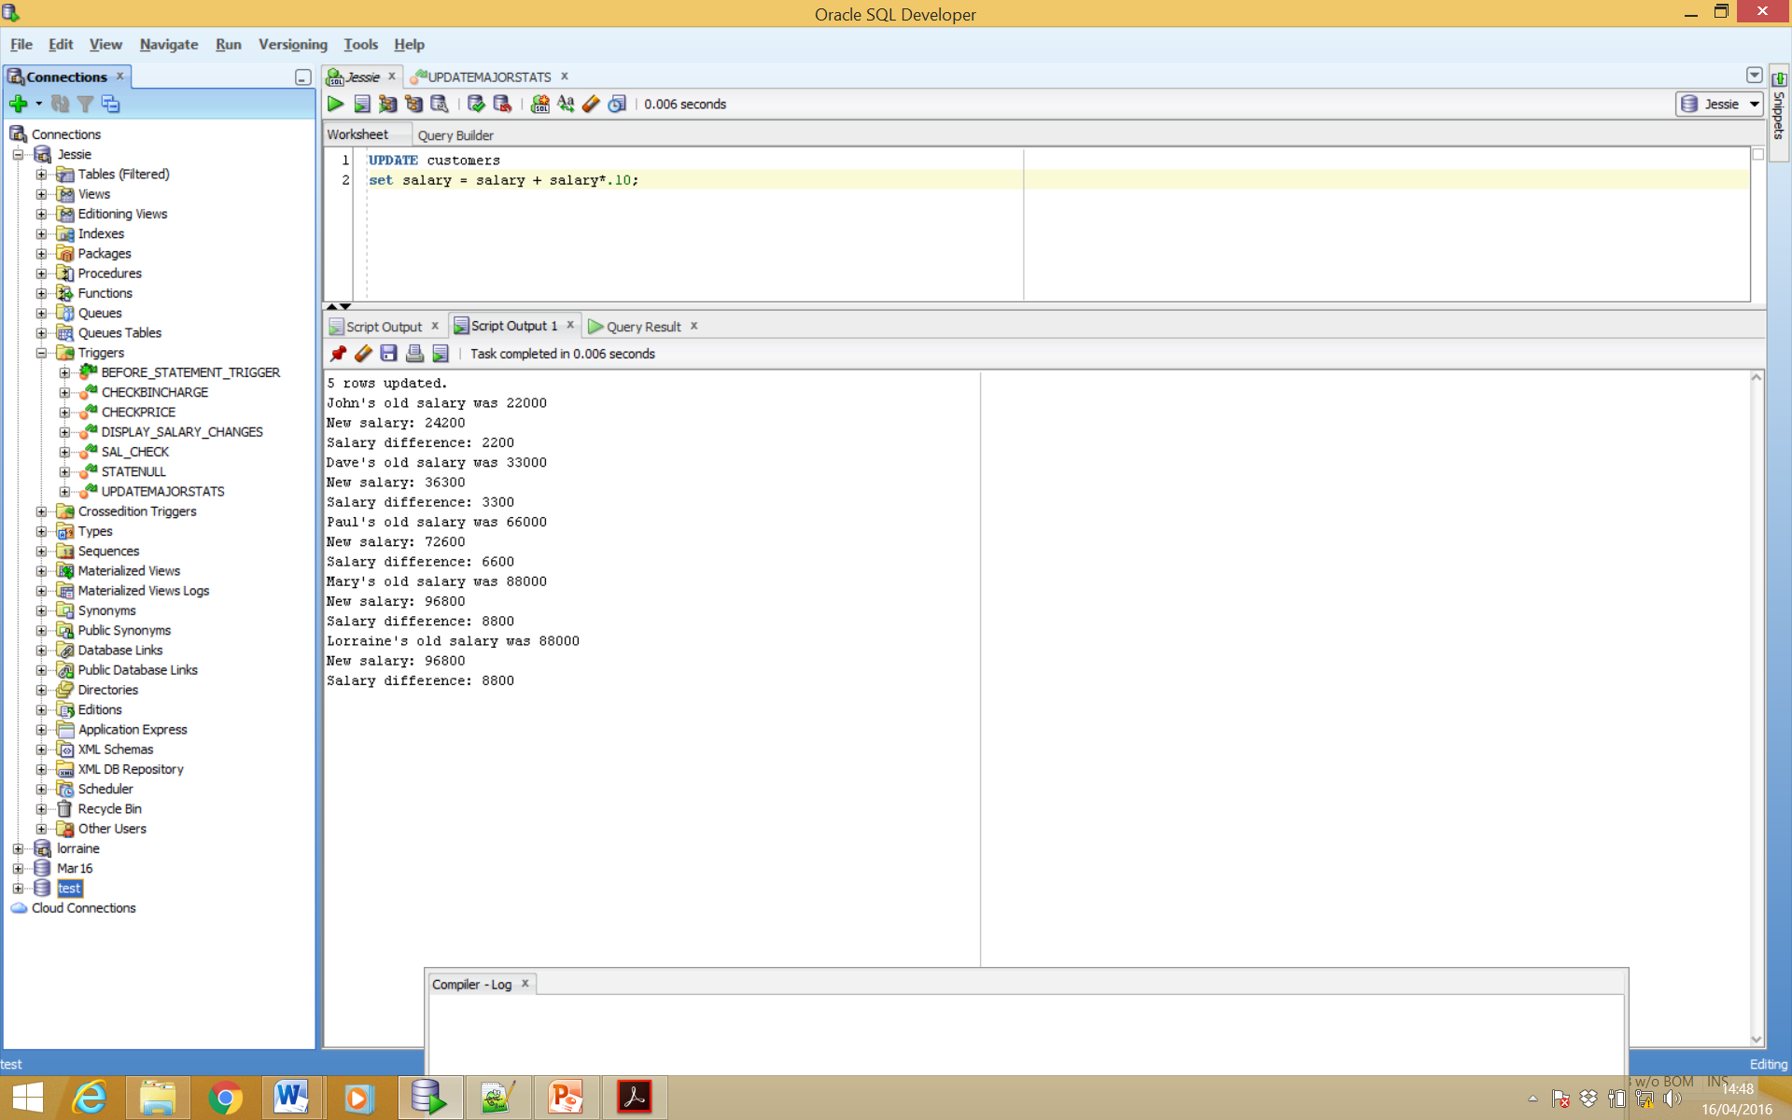
Trigger Sample - Update

Slide 68
Trigger Practice
Create an Employee table
Input 6 rows of sample data into table e.g.
Insert into employee ('1001', 'John', 'Tallaght', '01-Apr-96', 30000);
Note: No employee should earn over 50000
CREATE TABLE employee (
emp_id NUMBER,
Emp_name VARCHAR2(25),
Emp_add VARCHAR2(35),
Emp_dob VARCHAR2(20),
Emp_salary NUMBER,
Primary Key(emp_id)
);

Slide 69
Task 1
Create a trigger for that table that will fire when a new employee is inserted into the table with a salary > 50000.
The trigger should be a BEFORE, ROW LEVEL trigger.
The trigger should display a message to the user that employee cannot be hired at the salary inserted.

Slide 70
Task 2
Create a trigger for that table that will show old and new salaries following an update on a employee record.
The trigger should be a BEFORE, ROW LEVEL trigger.
The trigger should display a message to the user showing the employee name, the old salary, the new salary and the difference between both.

